Slide 1
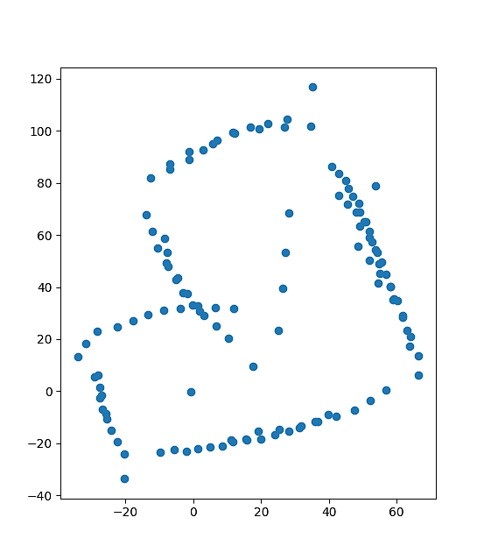
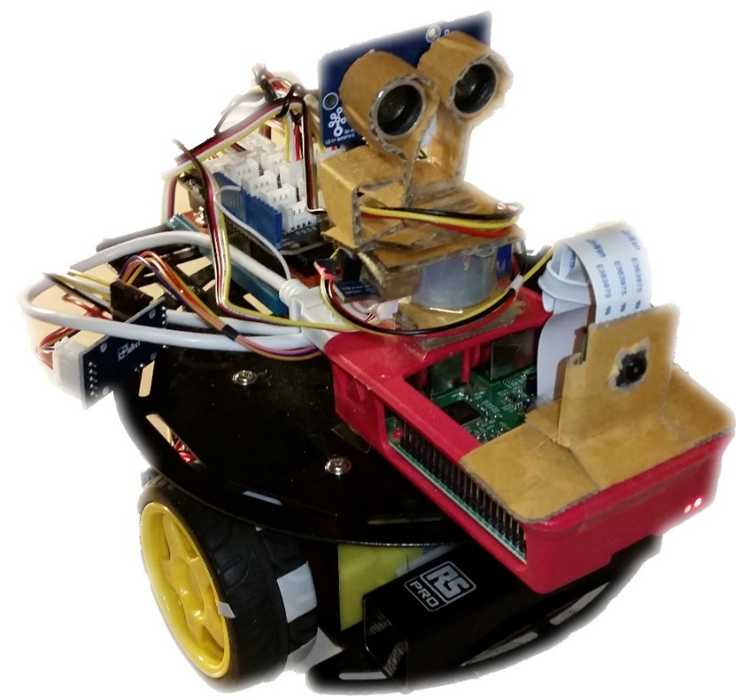
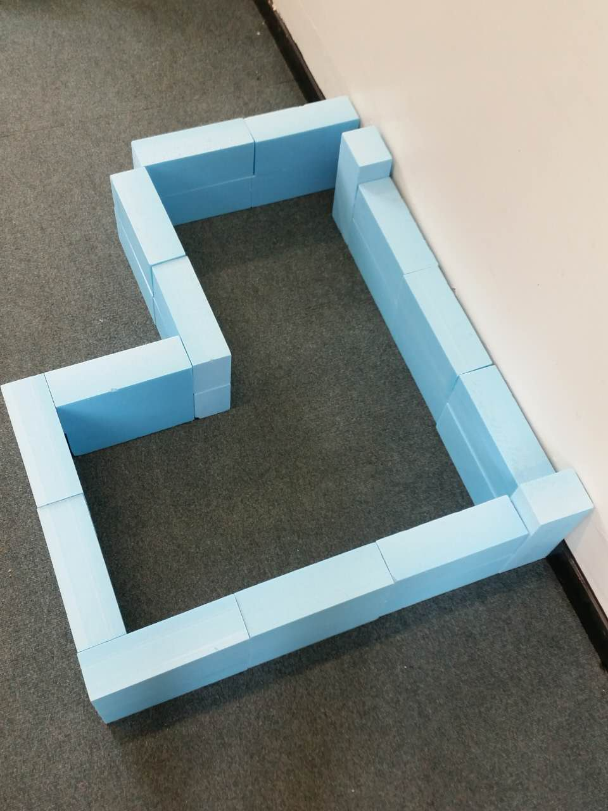
Autonomous Vehicle
with 2D Mapping
Zixiang Lu

Slide 2
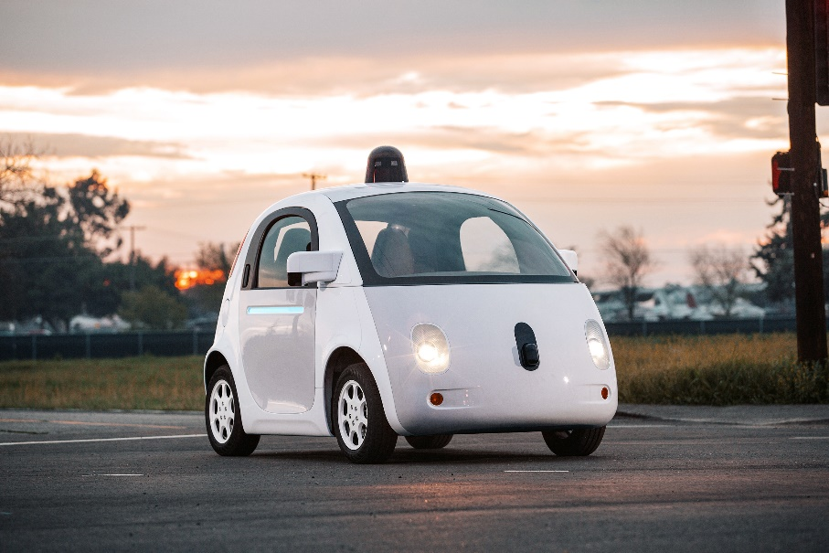

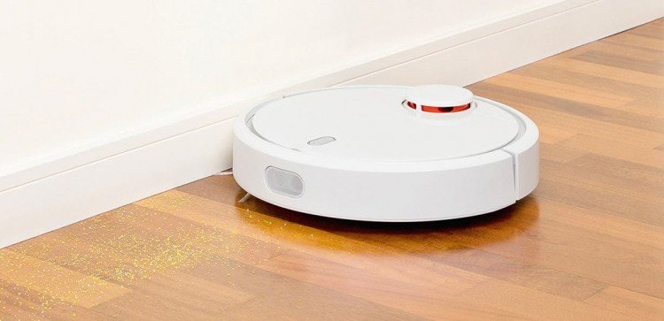

Introduction
Navigation

Slide 3
Introduction
Mapping
&
Localizing

Slide 4
Aims & Objectives
Aims
Indoor autonomous mapping vehicle
Objectives
Do relevant research
Construct a robotic platform
Integrated sensors on the platform
Develop a mapping algorithm
[Advanced] Integrate Raspberry Pi to the system for more advanced tasks

Slide 5

Ideas
Method 1:
Tracking Walls

Slide 6
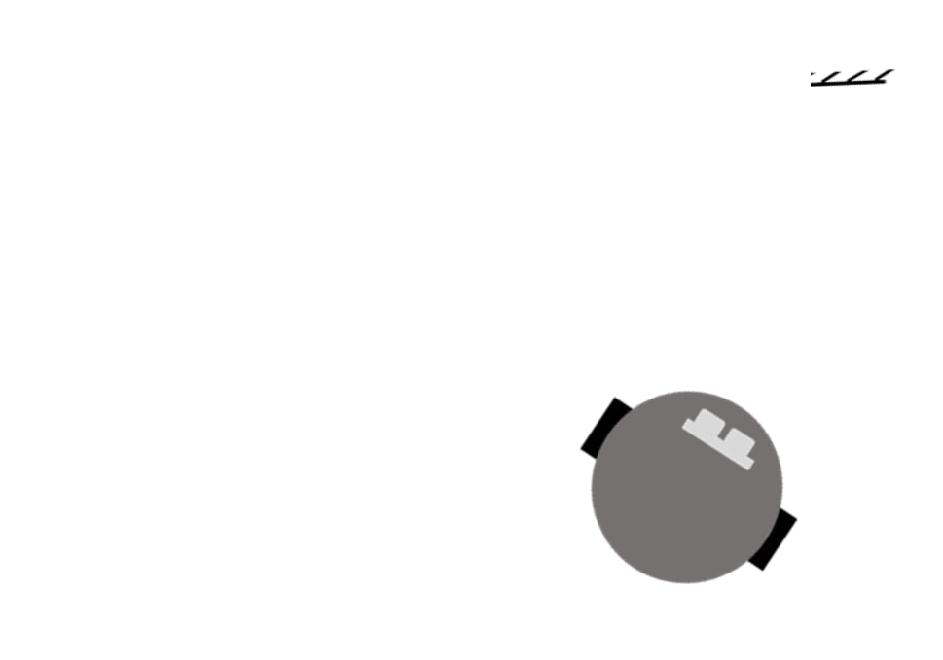
Ideas
Method 2:
Scanning Obstacles (Spinning)

Slide 7

Ideas
Method 2:
Scanning Obstacles (Spinning)

Slide 8

Ideas
Method 3:
Scanning Obstacles (Radar)

Slide 9
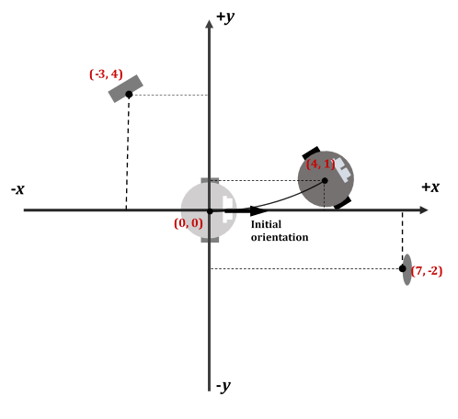
Design
Step 1:
Creating a Global coordinate system

Slide 10
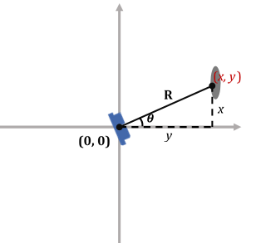
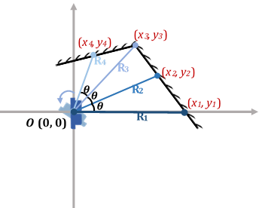
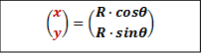
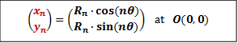
Design
Step 2:
Statically mapping obstacles

Slide 11
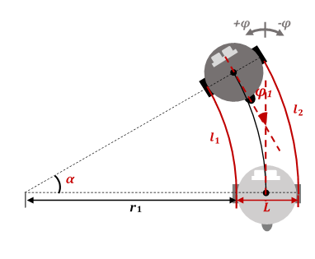
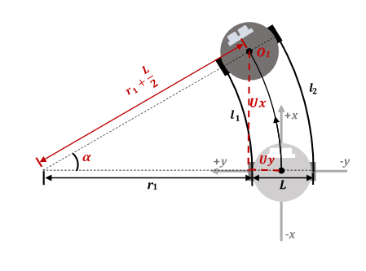
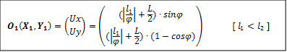
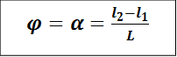
Design
Step 3:
Logging vehicle position

Slide 12
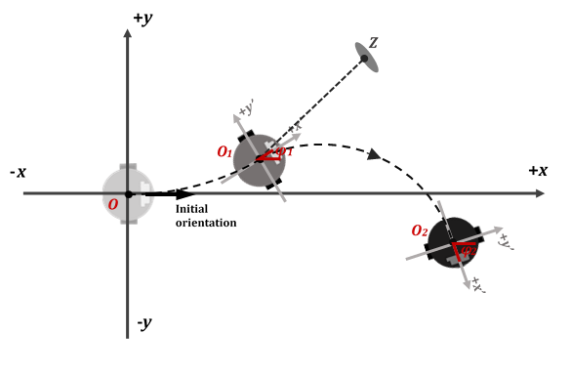


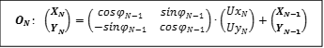
Design
Step 4:
Converting coordinate systems

Slide 13
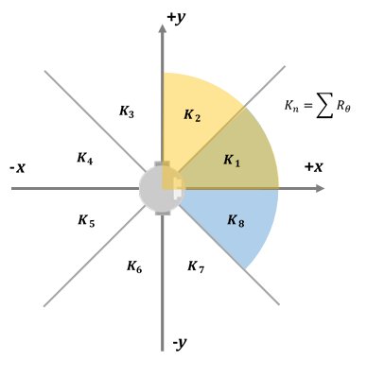

Design
Step 5:
Route planning

Slide 14
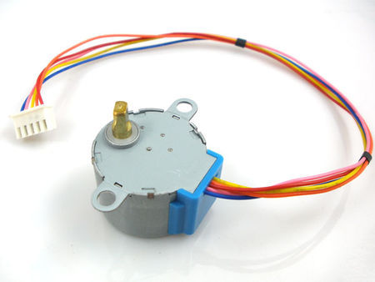
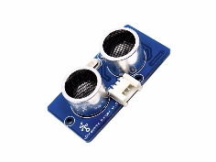
Implementation
Ultrasonic Radar

Slide 15
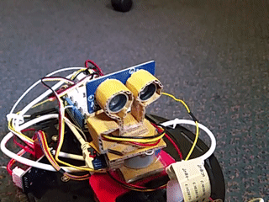
Implementation
Ultrasonic Radar

Slide 16
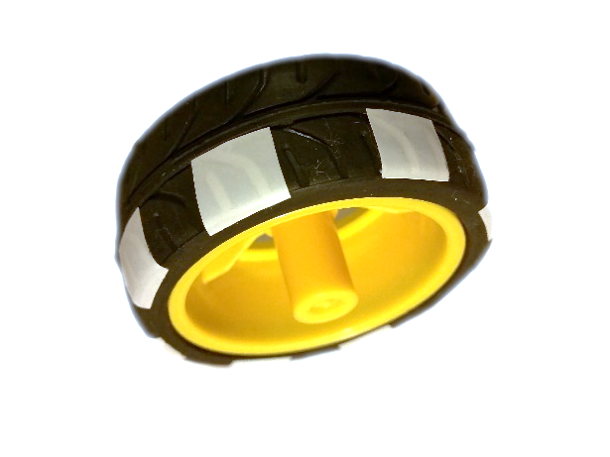
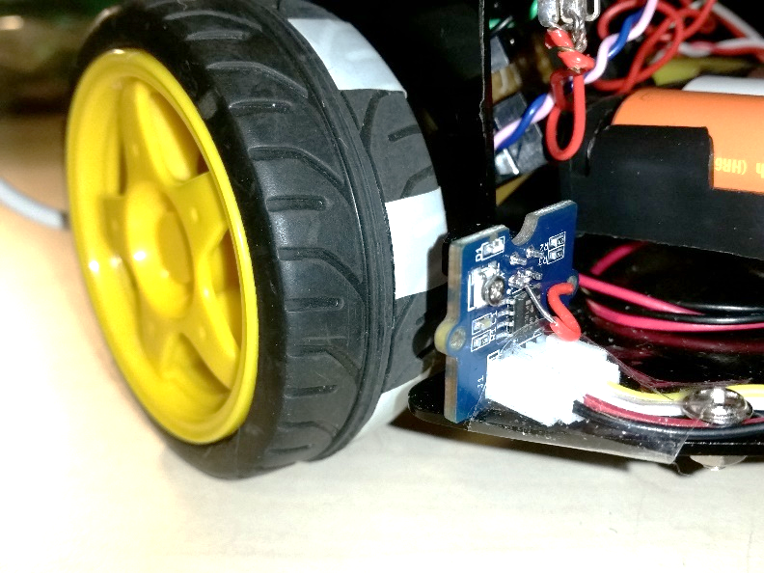
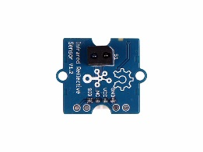
Implementation
Wheel Odometer

Slide 17
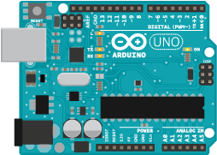
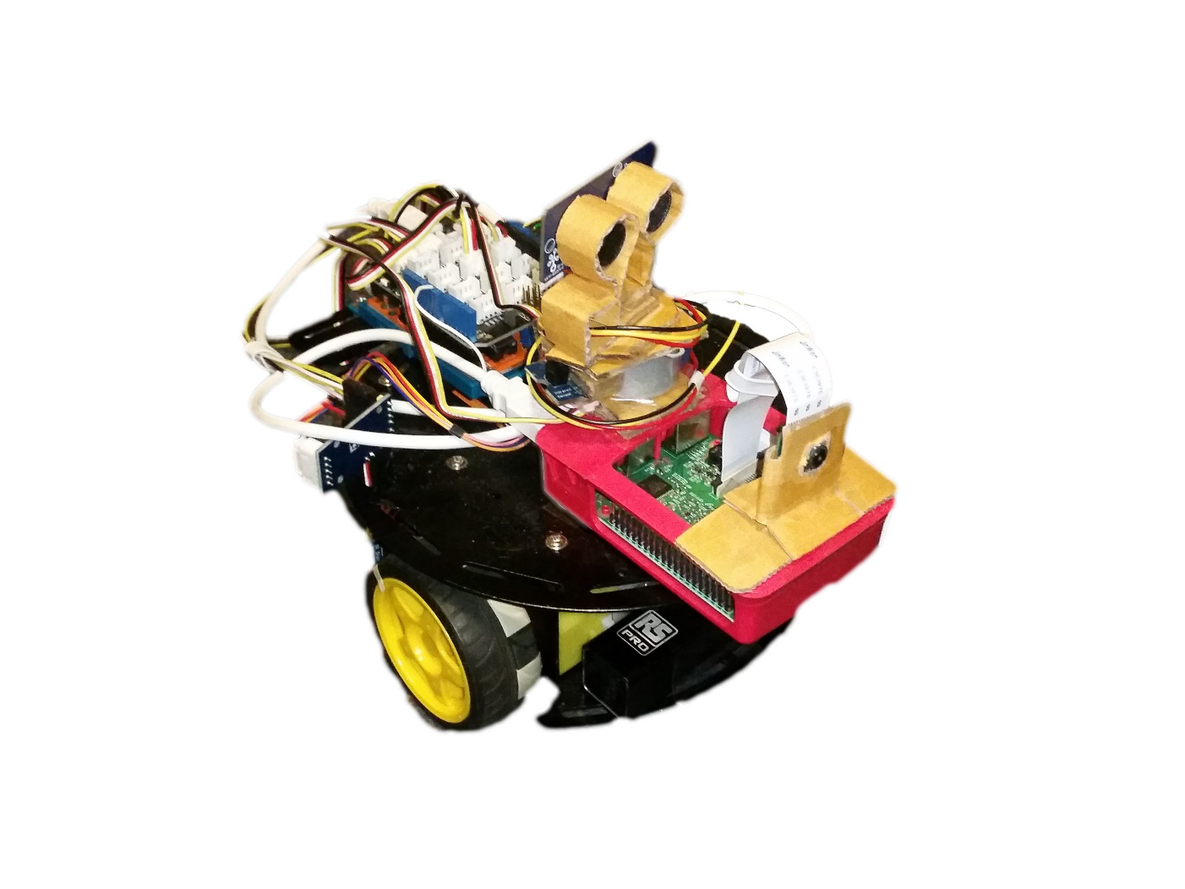
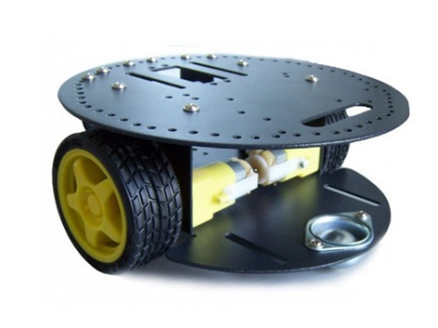
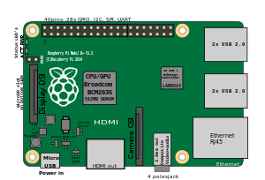
Implementation

Slide 18
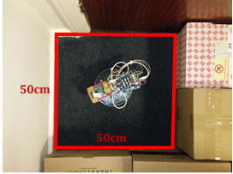
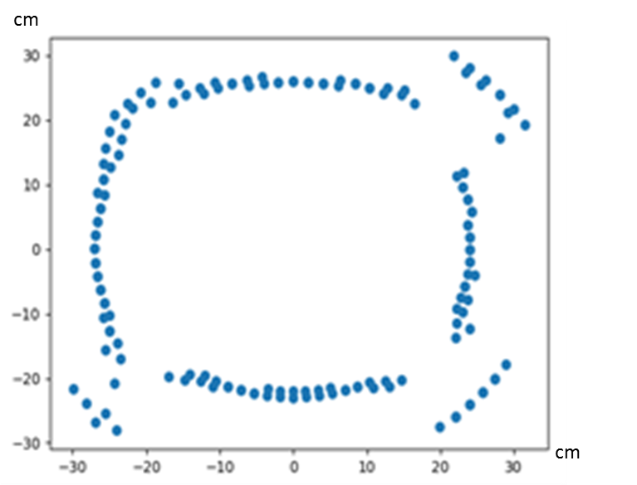
Testing & Results
Test 1:
Static mapping
imperfect at corners
straight wall is curved

Slide 19
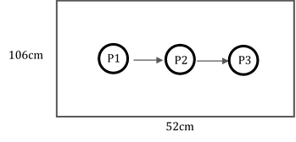
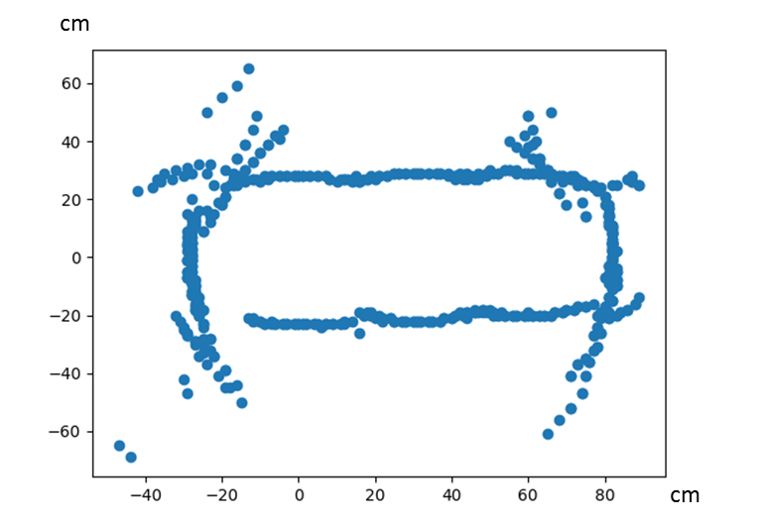
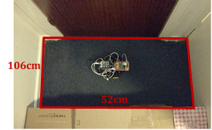
Testing & Results
Test 2:
Dynamic mapping (without route planner)
ridiculous points

Slide 20
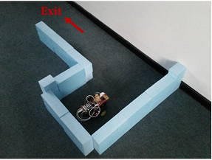
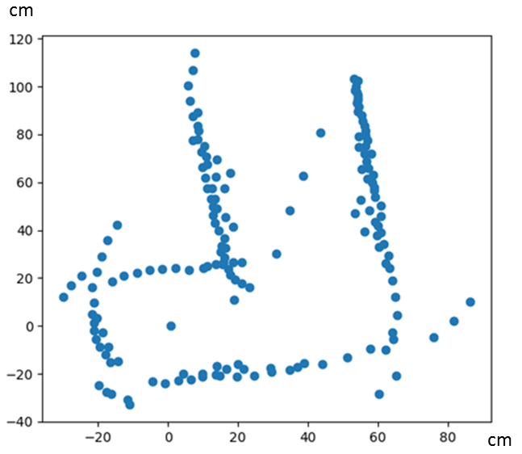
Testing & Results
Test 3:
Dynamic mapping (with route planner)

Slide 21
Testing & Results
Test 3:
Dynamic mapping (with route planner)
Video:
https://youtu.be/nB8XvEBVgZQ

Slide 22
Conclusion
Strength
Low cost
Simple control
Real time map display
Weakness
Imperfect at corners
Imperfect at straight walls
Relatively slow

Slide 23
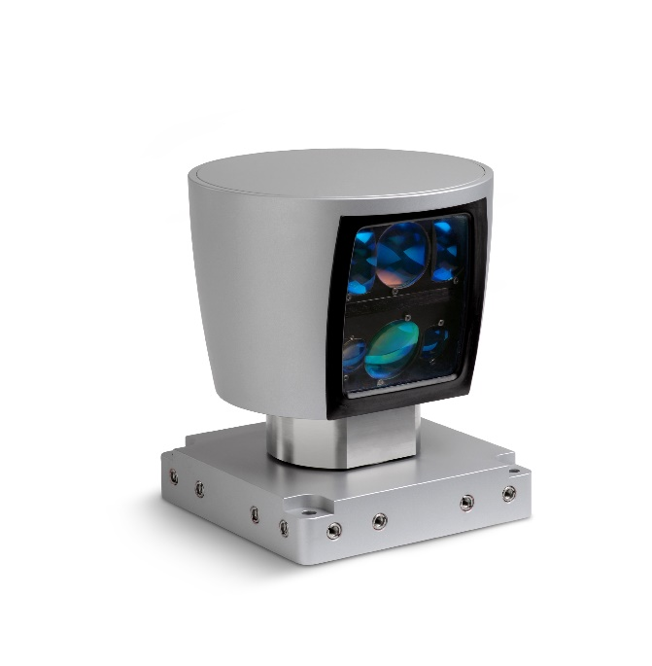
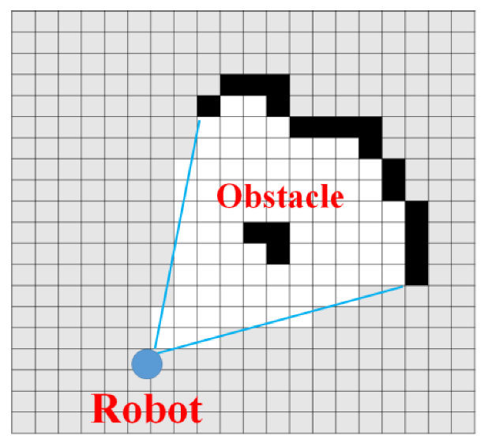
Conclusion
Improvements

Slide 24
Conclusion
Introduction
Ideas
Design
Implementation
Testing & Results

